Slide 1
Days since-until App
ArunKumar Kanakasabai

Slide 2
Days sintil app
The app calculates the number of days since the event had happened to till date called days since
&
It calculates the number of days preceding to an event called days until

Slide 3
Project Proposal : Days Sintil App- iPhone
Scope of Work :
To determine the number of days since an event had happened to till date and to calculate the number of days preceding to an event

Slide 4
App features
Logo at the top
Two tabs one each for days since and days until
Textbox to get user date input
Textbox to get event name
Calculate button to calculate the number of days
Message box to display the event message and the number of days since the event had occurred or the number of days preceding to the event

Slide 5
Mobile software development steps
Phase 1 – Layout
Phase 2 – Pace algorithms
Phase 3 - testing

Slide 6
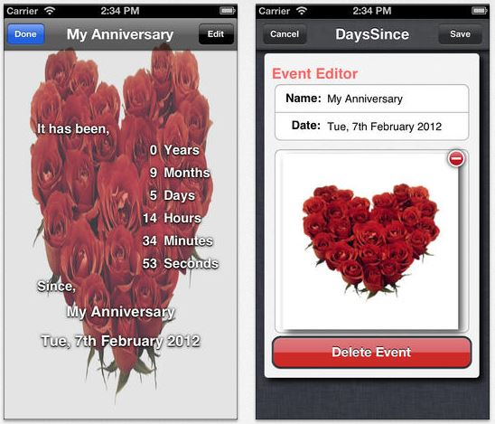
Mobile Landscape : iPhone – Days since

Slide 7
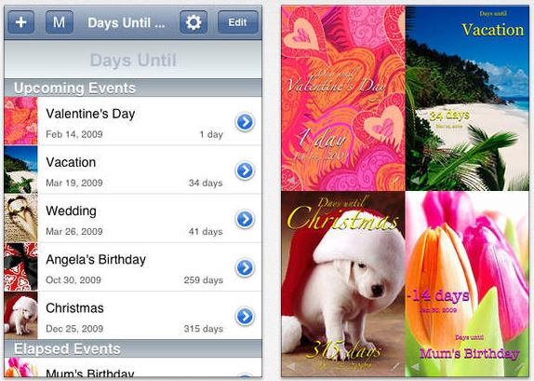
Mobile Landscape : iPhone – Days until

Slide 8
What makes app unique
Personalized design
Simple interface

